Slide 1

Optimization Algorithms
Understanding exponentially weighted averages
deeplearning.ai

Slide 2
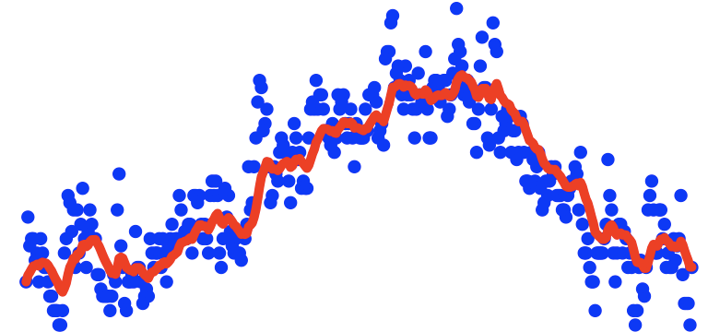
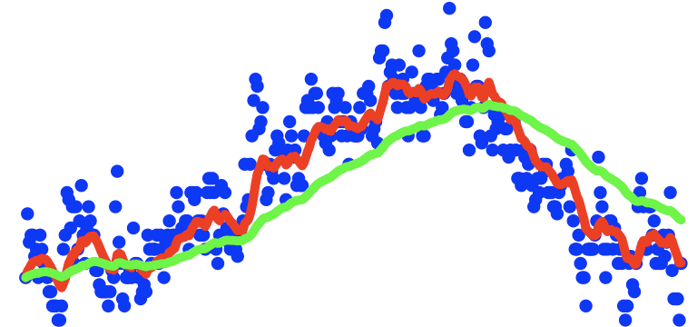
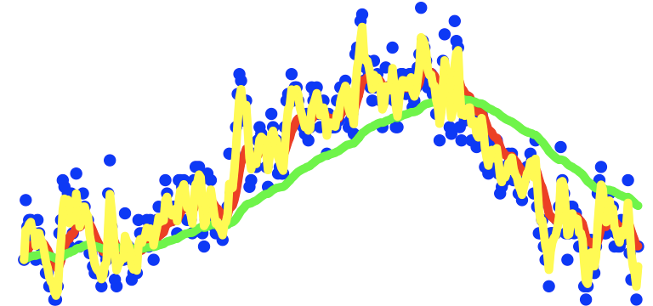
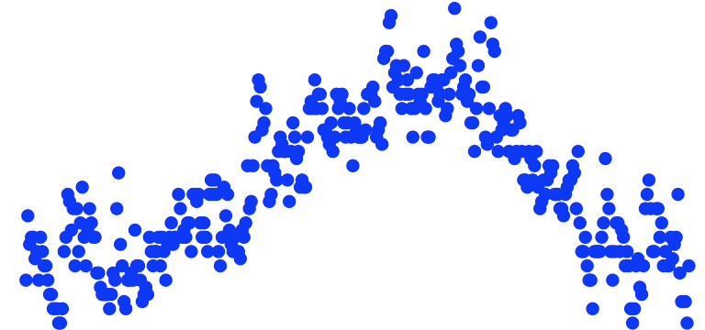

Exponentially weighted averages
$$v_{t}=βv_{t−1}+(1−β)θ_{t}$$
temperature
days

Slide 3
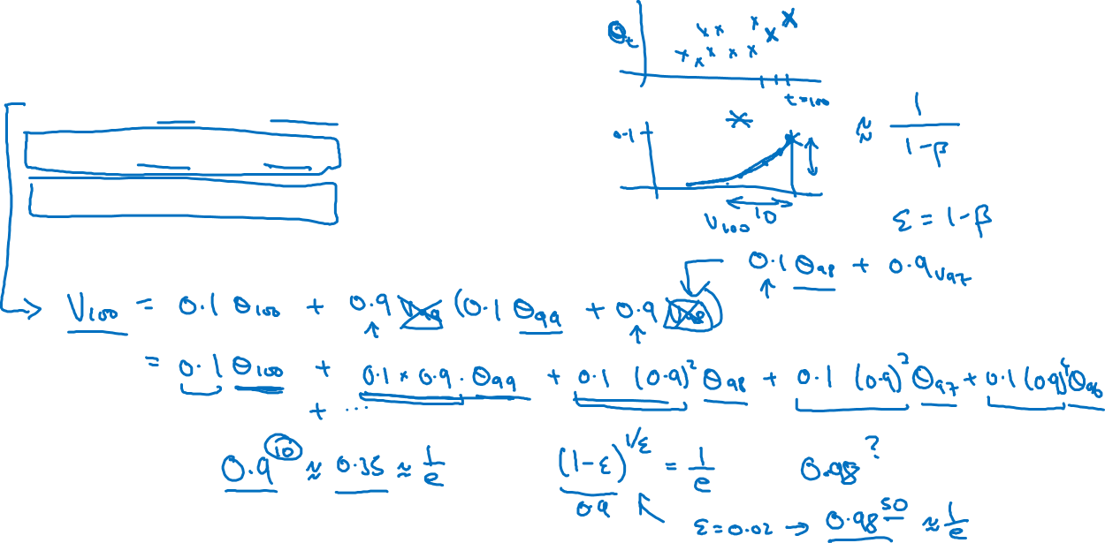





Exponentially weighted averages
$$v_{t}=βv_{t−1}+(1−β)θ_{t}$$
$$v_{100}=0.9v_{99}+0.1θ_{100}$$
$$v_{99}=0.9v_{98}+0.1θ_{99}$$
$$v_{98}=0.9v_{97}+0.1θ_{98}$$
$$…$$

Slide 4
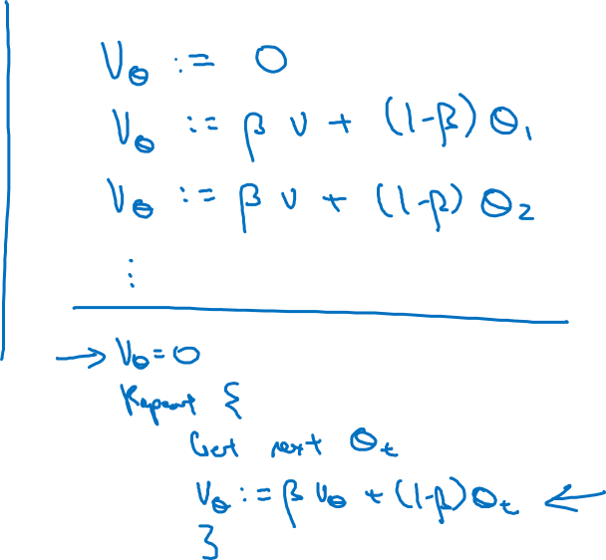





Implementing exponentially weighted averages
$$v_{0}=0$$
$$v_{1}=βv_{0}+(1−β) θ_{1}$$
$$v_{2}=βv_{1}+(1−β) θ_{2}$$
$$v_{3}=βv_{2}+(1−β) θ_{3}$$
$$…$$

